Slide 1
Chapter 4 : Intermediate SQL

Slide 2
Outline
Join Expressions
Views
Transactions
Integrity Constraints
SQL Data Types and Schemas
Index Definition in SQL
Authorization
Notes:
1

Slide 3
Joined Relations
Join operations take two relations and return as a result another relation.
A join operation is a Cartesian product which requires that tuples in the two relations match (under some condition). It also specifies the attributes that are present in the result of the join
The join operations are typically used as subquery expressions in the from clause
Three types of joins:
Natural join
Inner join
Outer join

Slide 4
Natural Join in SQL
Natural join matches tuples with the same values for all common attributes, and retains only one copy of each common column.
List the names of instructors along with the course ID of the courses that they taught
select name, course_id from students, takes where student.ID = takes.ID;
Same query in SQL with “natural join” construct
select name, course_id from student natural join takes;

Slide 5
Natural Join in SQL (Cont.)
The from clause can have multiple relations combined using natural join:
select A₁, A₂, … A_{n} from r₁ natural join r₂ natural join .. natural join r_{n} where P ;

Slide 6
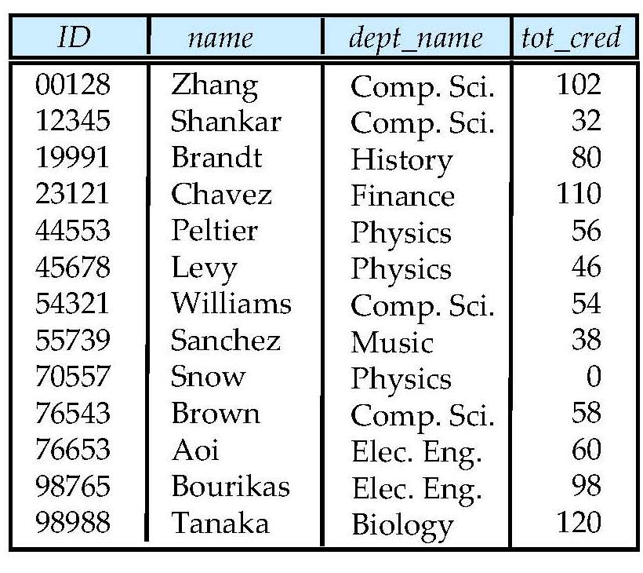
Student Relation

Slide 7
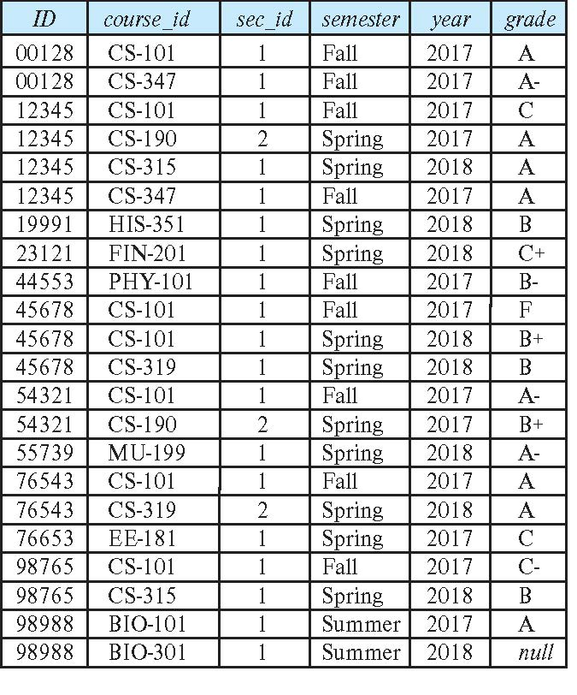
Takes Relation

Slide 8
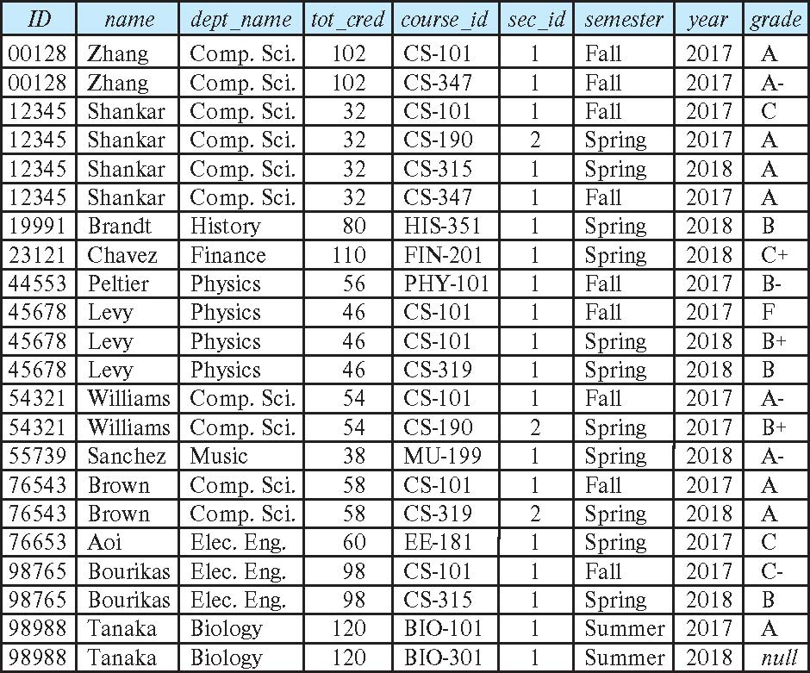
student natural join takes

Slide 9
Dangerous in Natural Join
Beware of unrelated attributes with same name which get equated incorrectly
Example -- List the names of students instructors along with the titles of courses that they have taken
Correct version
select name, title from student natural join takes, course where takes.course_id = course.course_id;
Incorrect version
select name, title from student natural join takes natural join course;
This query omits all (student name, course title) pairs where the student takes a course in a department other than the student's own department.
The correct version (above), correctly outputs such pairs.

Slide 10
Natural Join with Using Clause
To avoid the danger of equating attributes erroneously, we can use the “using” construct that allows us to specify exactly which columns should be equated.
Query example
select name, title from (student natural join takes) join course using (course_id)

Slide 11
Join Condition / Inner Join
The on condition allows a general predicate over the relations being joined
This predicate is written like a where clause predicate except for the use of the keyword on
Query example
select * from student join takes on student_ID = takes_ID
The on condition above specifies that a tuple from student matches a tuple from takes if their ID values are equal.
Equivalent to:
select * from student , takes where student_ID = takes_ID

Slide 12
Outer Join
An extension of the join operation that avoids loss of information.
Computes the join and then adds tuples form one relation that does not match tuples in the other relation to the result of the join.
Uses null values.
Three forms of outer join:
left outer join
right outer join
full outer join

Slide 13
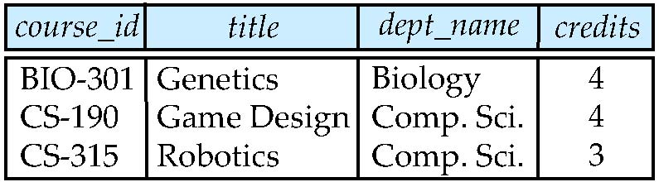
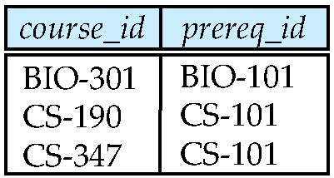
Outer Join Examples
Relation course
Relation prereq
Observe that
course information is missing CS-347
prereq information is missing CS-315

Slide 14
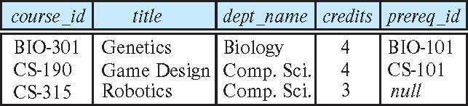
Left Outer Join
course natural left outer join prereq
In relational algebra: course ⟕ prereq

Slide 15
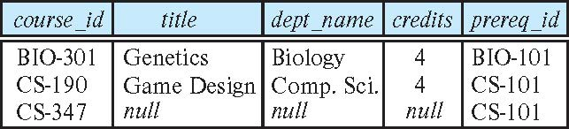
Right Outer Join
course natural right outer join prereq
In relational algebra: course ⟖ prereq

Slide 16
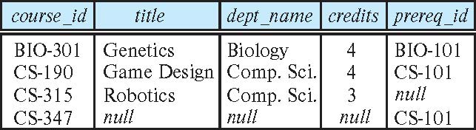
Full Outer Join
course natural full outer join prereq
In relational algebra: course ⟗ prereq

Slide 17
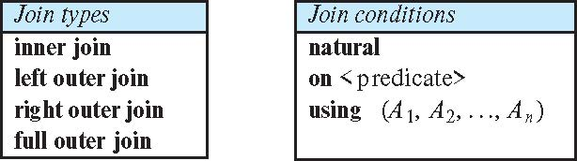
Joined Types and Conditions
Join operations take two relations and return as a result another relation.
These additional operations are typically used as subquery expressions in the from clause
Join condition – defines which tuples in the two relations match.
Join type – defines how tuples in each relation that do not match any tuple in the other relation (based on the join condition) are treated.

Slide 18
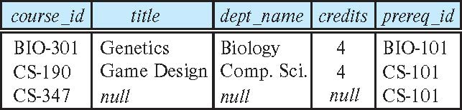
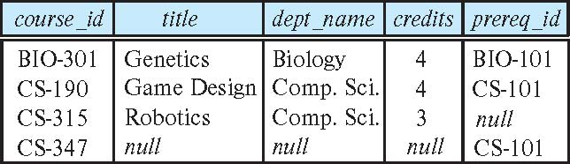
Joined Relations – Examples
course natural right outer join prereq
course full outer join prereq using (course_id)

Slide 19
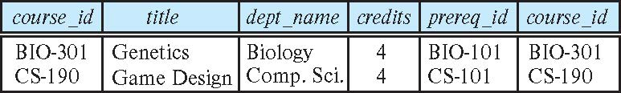
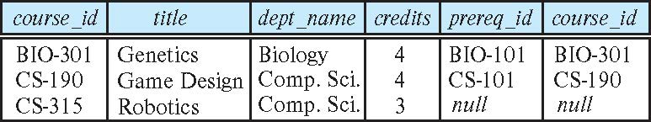
Joined Relations – Examples
course inner join prereq on course.course_id = prereq.course_id
What is the difference between the above, and a natural join?
course left outer join prereq on course.course_id = prereq.course_id

Slide 20
Joined Relations – Examples
course natural right outer join prereq
course full outer join prereq using (course_id)

Slide 21
Class Activity: Understanding Joins through Algebra and SQL
Students(StudentId, Name, Major)
Courses (CourseId, CourseName, Major)
Question 1: Inner Join on “Major”
(A). Write the algebraic expression that represents an inner join of two sets S (Students) and C (Courses) on the attribute Major. Both S and C have the attributes StudentID, Name, CourseID, CourseName, and Major.
(B). Construct an SQL query to perform an inner join between the tables Students and Courses using the column Major as the join condition.
Question 2: Natural Join
(A). write the algebraic expression for performing a natural join on S and C.
(B). Write an SQL query to execute a natural join between the Students and Courses tables, assuming they share the common column Major.

Slide 22
Views
In some cases, it is not desirable for all users to see the entire logical model (that is, all the actual relations stored in the database.)
Consider a person who needs to know an instructors name and department, but not the salary. This person should see a relation described, in SQL, by select ID, name, dept_name from instructor
A view provides a mechanism to hide certain data from the view of certain users.
Any relation that is not of the conceptual model but is made visible to a user as a “virtual relation” is called a view.

Slide 23
View Definition
A view is defined using the create view statement which has the form
create view v as < query expression >
where <query expression> is any legal SQL expression. The view name is represented by v.
Once a view is defined, the view name can be used to refer to the virtual relation that the view generates.
View definition is not the same as creating a new relation by evaluating the query expression
Rather, a view definition causes the saving of an expression; the expression is substituted into queries using the view.

Slide 24
View Definition and Use
A view of instructors without their salary
create view faculty as select ID, name, dept_name from instructor
Find all instructors in the Biology department
select name from faculty where dept_name = 'Biology'
Create a view of department salary totals
create view departments_total_salary(dept_name, total_salary) as select dept_name, sum (salary) from instructor group by dept_name;

Slide 25
Views Defined Using Other Views
One view may be used in the expression defining another view
A view relation v₁ is said to depend directly on a view relation v₂ if v₂ is used in the expression defining v₁
A view relation v₁ is said to depend on view relation v₂ if either v₁ depends directly to v₂ or there is a path of dependencies from v₁ to v₂
A view relation v is said to be recursive if it depends on itself.

Slide 26
Views Defined Using Other Views
create view physics_fall_2017 as select course.course_id, sec_id, building, room_number from course, section where course.course_id = section.course_id and course.dept_name = 'Physics' and section.semester = 'Fall' and section.year = '2017’;
create view physics_fall_2017_watson as select course_id, room_number from physics_fall_2017 where building= 'Watson';

Slide 27
View Expansion
Expand the view :
create view physics_fall_2017_watson as select course_id, room_number from physics_fall_2017 where building= 'Watson'
To:
create view physics_fall_2017_watson as
select course_id, room_number
from (select course.course_id, building, room_number
from course, section
where course.course_id = section.course_id
and course.dept_name = 'Physics'
and section.semester = 'Fall'
and section.year = '2017')
where building= 'Watson';

Slide 28
View Expansion (Cont.)
A way to define the meaning of views defined in terms of other views.
Let view v₁ be defined by an expression e₁ that may itself contain uses of view relations.
View expansion of an expression repeats the following replacement step:
repeat Find any view relation v_{i} in e₁ Replace the view relation v_{i} by the expression defining v_{i} until no more view relations are present in e₁
As long as the view definitions are not recursive, this loop will terminate

Slide 29
Materialized Views
Certain database systems allow view relations to be physically stored.
Physical copy created when the view is defined.
Such views are called Materialized view:
If relations used in the query are updated, the materialized view result becomes out of date
Need to maintain the view, by updating the view whenever the underlying relations are updated.

Slide 30
Update of a View
Add a new tuple to faculty view which we defined earlier
insert into faculty
values ('30765', 'Green', 'Music');
This insertion must be represented by the insertion into the instructor relation
Must have a value for salary.
Two approaches
Reject the insert
Insert the tuple
('30765', 'Green', 'Music', null)
into the instructor relation

Slide 31
Some Updates Cannot be Translated Uniquely
create view instructor_info as select ID, name, building from instructor, department where instructor.dept_name = department.dept_name;
insert into instructor_info
values ('69987', 'White', 'Taylor');
Issues
Which department, if multiple departments in Taylor?
What if no department is in Taylor?
Notes:
1. Ambiguity in Mapping to Underlying Tables:
Specifically, ID and name logically belong to instructor, and building logically belongs to department, but the relationship between name and building (through dept_name) is not directly represented in the insert values.
2. Multiple Departments in the Same Building:
3. No Matching Department:

Slide 32
And Some Not at All
create view history_instructors as select * from instructor where dept_name= 'History';
What happens if we insert
('25566', 'Brown', 'Biology', 100000)
into history_instructors?
1. Insertion into Underlying Table
2. View Does Not Display the New Record

Slide 33
View Updates in SQL
Most SQL implementations allow updates only on simple views
The from clause has only one database relation.
The select clause contains only attribute names of the relation, and does not have any expressions, aggregates, or distinct specification.
Any attribute not listed in the select clause can be set to null
The query does not have a group by or having clause.
Notes:
These conditions aim to ensure that any updates made through the view can be unambiguously applied to the underlying base table(s).

Slide 34
Class Activity
1. What is abc in the following MySQL statement?
a) row name b) column name
c) view d) database
CREATE VIEW xyz (abc) AS SELECT a FROM t;

Slide 35
Transactions
A transaction consists of a sequence of query and/or update statements and is a “unit” of work
The SQL standard specifies that a transaction begins implicitly when an SQL statement is executed.
The transaction must end with one of the following statements:
Commit work. The updates performed by the transaction become permanent in the database.
Rollback work. All the updates performed by the SQL statements in the transaction are undone.
Atomic transaction
either fully executed or rolled back as if it never occurred
Isolation from concurrent transactions

Slide 36
Integrity Constraints
Integrity constraints guard against accidental damage to the database, by ensuring that authorized changes to the database do not result in a loss of data consistency.
A checking account must have a balance greater than $10,000.00
A salary of a bank employee must be at least $4.00 an hour
A customer must have a (non-null) phone number

Slide 37
Constraints on a Single Relation
not null
primary key
unique
check (P), where P is a predicate

Slide 38
Not Null Constraints
not null
Declare name and budget to be not null
name varchar(20) not null budget numeric(12,2) not null

Slide 39
Unique Constraints
unique ( A₁, A₂, …, A_{m})
The unique specification states that the attributes A₁, A₂, …, A_{m} form a candidate key.
Candidate keys are permitted to be null (in contrast to primary keys).

Slide 40
The check clause
The check (P) clause specifies a predicate P that must be satisfied by every tuple in a relation.
Example: ensure that semester is one of fall, winter, spring or summer
create table section
(course_id varchar (8),
sec_id varchar (8),
semester varchar (6),
year numeric (4,0),
building varchar (15),
room_number varchar (7),
time slot id varchar (4),
primary key (course_id, sec_id, semester, year),
check (semester in ('Fall', 'Winter', 'Spring', 'Summer')))

Slide 41
Referential Integrity
Ensures that a value that appears in one relation for a given set of attributes also appears for a certain set of attributes in another relation.
Example: If “Biology” is a department name appearing in one of the tuples in the instructor relation, then there exists a tuple in the department relation for “Biology”.
Let A be a set of attributes. Let R and S be two relations that contain attributes A and where A is the primary key of S. A is said to be a foreign key of R if for any values of A appearing in R these values also appear in S.

Slide 42
Referential Integrity (Cont.)
Foreign keys can be specified as part of the SQL create table statement
foreign key (dept_name) references department
By default, a foreign key references the primary-key attributes of the referenced table.
SQL allows a list of attributes of the referenced relation to be specified explicitly.
foreign key (dept_name) references department (dept_name)

Slide 43
Cascading Actions in Referential Integrity
When a referential-integrity constraint is violated, the normal procedure is to reject the action that caused the violation.
An alternative, in case of delete or update is to cascade
create table course ( (… dept_name varchar(20), foreign key (dept_name) references department on delete cascade on update cascade, . . .)
Instead of cascade we can use :
set null,
set default

Slide 44
Integrity Constraint Violation During Transactions
Consider:
create table person ( ID char(10), name char(40), mother char(10), father char(10), primary key ID, foreign key father references person, foreign key mother references person)
How to insert a tuple without causing constraint violation?
Insert father and mother of a person before inserting person
OR, set father and mother to null initially, update after inserting all persons (not possible if father and mother attributes declared to be not null)
OR defer constraint checking -> Order matters, set foreign_key_checks=0/1

Slide 45
-- Insert father
INSERT INTO person (ID, name) VALUES ("001", "Urgessa");
#Insert Mother
INSERT INTO person (ID, name) VALUES ("002", "Yeshi");
-- Now Insert child
INSERT INTO person (ID, name, mother, father) VALUES ("003", "Nashu", "001", "002");
/*Set Father and Mother to NULL Initially, Update After Inserting All Persons*/
-- Insert person without specifying parents
INSERT INTO person (ID, name) VALUES ('004', 'Baby Doe');
-- Update the record later when parents' data is available
UPDATE person SET father = '001', mother = '002' WHERE ID = '004';
BEGIN;
INSERT INTO person (ID, name) VALUES ('005', 'Lila');
INSERT INTO person (ID, name) VALUES ('006', 'Dawit');
INSERT INTO person (ID, name, mother, father) VALUES ('007', 'Lillian', '005', '006');
COMMIT;
SET foreign_key_checks = 0;
INSERT INTO person (ID, name, mother, father) VALUES ('009', 'Alice', '0010', '0011');
INSERT INTO person (ID, name) VALUES ('0010', 'Bob');
INSERT INTO person (ID, name) VALUES ('0011', 'Carol');
SET foreign_key_checks = 1;

Slide 46
Complex Check Conditions
The predicate in the check clause can be an arbitrary predicate that can include a subquery.
check (time_slot_id in (select time_slot_id from time_slot))
The check condition states that the time_slot_id in each tuple in the section relation is actually the identifier of a time slot in the time_slot relation.
The condition has to be checked not only when a tuple is inserted or modified in section , but also when the relation time_slot changes
Changes in the Reference Table: The condition must also be checked when changes occur in the time_slot table. If a time_slot_id is deleted from the time_slot table, it must be ensured that no records in the section table continue to reference that time_slot_id.
This is more complex because it requires maintaining the integrity of the section table not only based on its own changes but also based on the changes in the time_slot table.
Not Suppoerted by MySQL / use foreignkey references instead.

Slide 47
Assertions
An assertion is a predicate expressing a condition that we wish the database always to satisfy.
The following constraints, can be expressed using assertions:
For each tuple in the student relation, the value of the attribute tot_cred must equal the sum of credits of courses that the student has completed successfully.
An instructor cannot teach in two different classrooms in a semester in the same time slot
An assertion in SQL takes the form:
create assertion <assertion-name> check (<predicate>);
CREATE ASSERTION DepartmentBudgetLimit CHECK (
NOT EXISTS (
SELECT 1
FROM Employees e
JOIN DepartmentBudgets d ON e.department_id = d.department_id
GROUP BY e.department_id
HAVING SUM(e.salary) > d.budget
)
);

Slide 48
Built-in Data Types in SQL
date: Dates, containing a (4 digit) year, month and date
Example: date '2005-7-27'
time: Time of day, in hours, minutes and seconds.
Example: time '09:00:30' time '09:00:30.75'
timestamp: date plus time of day
Example: timestamp '2005-7-27 09:00:30.75'
interval: period of time
Example: interval '1' day
Subtracting a date/time/timestamp value from another gives an interval value
Interval values can be added to date/time/timestamp values
-- Subtracting two dates to get an interval
SELECT TIMESTAMP '2023-04-25 08:00:00' - DATE '2023-04-20';
-- Adding an interval to a date
SELECT TIMESTAMP '2023-04-25 08:00:00' + INTERVAL '5' DAY;
-- Extracting parts of a date
SELECT EXTRACT(YEAR FROM TIMESTAMP '2023-04-25 08:00:00');

Slide 49
Large-Object Types
Large objects (photos, videos, CAD files, etc.) are stored as a large object:
blob: binary large object -- object is a large collection of uninterpreted binary data (whose interpretation is left to an application outside of the database system)
clob: character large object -- object is a large collection of character data
When a query returns a large object, a pointer is returned rather than the large object itself.

Slide 50
User-Defined Types
create type construct in SQL creates user-defined type
create type Dollars as numeric (12,2) final
Example:
create table department (dept_name varchar (20), building varchar (15), budget Dollars);

Slide 51
Domains
create domain construct in SQL-92 creates user-defined domain types
Using domains can simplify database schema design and enforcement of data integrity by encapsulating validation rules within the data type definition itself.
create domain person_name char(20) not null
Types and domains are similar. Domains can have constraints, such as not null, specified on them.
Example:
create domain degree_level varchar(10) constraint degree_level_test check (value in ('Bachelors', 'Masters', 'Doctorate'));
CREATE TABLE student (
student_id INT,
name person_name, -- Using the domain
degree degree_level -- Using the domain
);

Slide 52
Index Creation
Many queries reference only a small proportion of the records in a table.
It is inefficient for the system to read every record to find a record with particular value
An index on an attribute of a relation is a data structure that allows the database system to find those tuples in the relation that have a specified value for that attribute efficiently, without scanning through all the tuples of the relation.
We create an index with the create index command
create index <name> on <relation-name> (attribute);

Slide 53
Index Creation Example
create table student (ID varchar (5), name varchar (20) not null, dept_name varchar (20), tot_cred numeric (3,0) default 0, primary key (ID))
create index studentID_index on student(ID)
The query:
select * from student where ID = '12345'
can be executed by using the index to find the required record, without looking at all records of student

Slide 54
Authorization
We may assign a user several forms of authorizations on parts of the database.
Read - allows reading, but not modification of data.
Insert - allows insertion of new data, but not modification of existing data.
Update - allows modification, but not deletion of data.
Delete - allows deletion of data.
Each of these types of authorizations is called a privilege. We may authorize the user all, none, or a combination of these types of privileges on specified parts of a database, such as a relation or a view.

Slide 55
Authorization (Cont.)
Forms of authorization to modify the database schema
Index - allows creation and deletion of indices.
Resources - allows creation of new relations.
Alteration - allows addition or deletion of attributes in a relation.
Drop - allows deletion of relations.

Slide 56
Authorization Specification in SQL
The grant statement is used to confer authorization
grant <privilege list> on <relation or view > to <user list>
<user list> is:
a user-id
public, which allows all valid users the privilege granted
A role (more on this later)
Example:
grant select on department to Amit, Satoshi
Granting a privilege on a view does not imply granting any privileges on the underlying relations.
The grantor of the privilege must already hold the privilege on the specified item (or be the database administrator).

Slide 57
Privileges in SQL
select: allows read access to relation, or the ability to query using the view
Example: grant users U₁, U₂, and U₃ select authorization on the instructor relation:
grant select on instructor to U₁, U₂, U₃
insert: the ability to insert tuples
update: the ability to update using the SQL update statement
delete: the ability to delete tuples.
all privileges: used as a short form for all the allowable privileges

Slide 58
Revoking Authorization in SQL
The revoke statement is used to revoke authorization.
revoke <privilege list> on <relation or view> from <user list>
Example:
revoke select on student from U₁, U₂, U₃
<privilege-list> may be all to revoke all privileges the revokee may hold.
If <revokee-list> includes public, all users lose the privilege except those granted it explicitly.
If the same privilege was granted twice to the same user by different grantees, the user may retain the privilege after the revocation.
All privileges that depend on the privilege being revoked are also revoked.

Slide 59
Roles
A role is a way to distinguish among various users as far as what these users can access/update in the database.
To create a role we use:
create a role <name>
Example:
create role instructor
Once a role is created we can assign “users” to the role using:
grant <role> to <users>

Slide 60
Roles Example
create role instructor;
grant instructor to Amit;
Privileges can be granted to roles:
grant select on takes to instructor;
Roles can be granted to users, as well as to other roles
create role teaching_assistant
grant teaching_assistant to instructor;
Instructor inherits all privileges of teaching_assistant
Chain of roles
create role dean;
grant instructor to dean;
grant dean to Satoshi;

Slide 61
Authorization on Views
create view geo_instructor as (select * from instructor where dept_name = 'Geology');
grant select on geo_instructor to geo_staff
Suppose that a geo_staff member issues
select * from geo_instructor;
What if
geo_staff does not have permissions on instructor?
Creator of view did not have some permissions on instructor?

Slide 62
Other Authorization Features
references privilege to create foreign key
grant reference (dept_name) on department to Mariano;
Why is this required?
transfer of privileges
grant select on department to Amit with grant option;
revoke select on department from Amit, Satoshi cascade;
revoke select on department from Amit, Satoshi restrict;
And more!

